Slide 1

Revisiting modern .NET for the FoxPro Interop Developer
Rick Strahl
West Wind Technologies
www.west-wind.com
www.west-wind.com/weblog
Session materials:
https://github.com/RickStrahl/VirtualFoxFest2022-FoxProDotnet

Slide 2








Rick Strahl
Big Kahuna & Janitor West Wind Technologies
Author and Speaker
Popular Blog: weblog.west-wind.com
ASP.NET Insider and MVP
Tools and Components
@RickStrahl
rstrahl@west-wind.com
weblog.west-wind.com

Slide 3
Why use .NET with FoxPro?
Extend FoxPro’s Reach
Add functionality otherwise not available
Easily accessible from FoxPro
Easy to create your own .NET code (compared to C++/Win32/COM)
Incrementally allows adding .NET to FoxPro for possible Migrations
Most popular services and APIs are exposed to .NET
System Functionality (Windows, APIs, Services)
Thousands of 3rd Party and OSS Libraries, APIs and Integrations
If it’s supported on Windows there likely is a .NET library for it!
. Modern .NET is different than old .NET
Easier to get started with
Tooling is built into a single installable SDK
Build, Test, Debug and Run from SDK and command line
Does not require Visual Studio or even Windows
But a full IDE (Visual Studio/Rider) is still more productive!

Slide 4
.NET Framework or .NET Core?
.NET Framework: the old workhorse
Pre-installed with Windows, always available
Best choice for FoxPro
Version 4.8 is last version (no new features)
.NET Core: the new and shiny
Multi-platform (Windows, Mac, Linux)
High performance, focus of Microsoft’s .NET strategy
Not pre-installed, runtime install required
wwDotnetBridge supports .NET Core as of v7
FoxPro -> .NET
Prefer using full Framework as your default target (target net472)
Use .NET Core only if you have to interface with Core only components
.NET Core instantiation only works with wwDotNetBridge

Slide 5
FoxPro and .NET Interop
COM Interop
Built-in, relies on COM semantics
Requires specially registered components (regAsm)
Very few native components support direct COM Interop
Essentially only works with components you write
wwDotnetBridge
Open Source library with many features
Registration-less instantiation of .NET Components
Access to most .NET Components
Allows access to features not available through COM

Slide 6
Why use wwDotnetBridge?
Registrationless .NET Access
No COM registration required for .NET Instantiation
Hosts .NET runtime in FoxPro
Instantiate .NET Types directly
Direct access to most .NET types
Access static methods and properties
Access features not supported by COM Interop
Access value types, enums, generics, decimals, longs etc.
Access collections and dictionaries
Call overloaded methods
Automatic Type Conversions available
Simplified Array/Collection/Dictionary handling with ComArray wrapper
Automatic data type conversions for unsupported types
It's free and Open Source
Hosted on Github: https://github.com/RickStrahl/wwDotnetBridge

Slide 7
How wwDotNetBridge Works
Architecture
Win32 CLR Loader loads .NET runtime into FoxPro
wwDotNetBridge .NET proxy loads into host domain
Objects are instantiated through proxy
Objects returned are COM instances (same as stock COM Interop)
Access values/object/members directly if possible
Or use proxy functions for COM unsupported functionality
Required Components
wwIPStuff.dll/crlLoader.dll – contains the native Win32 Loader
wwDotNetBridge.dll - .NET class: Loader and Proxy
wwDotNetBridge.prg – FoxPro front-end for .NET class

Slide 8
wwDotNetBridge Architecture
Hosting Process (YourApp.exe)
.NET Runtime Host (Application Domain)
.NET Object call methods and access properties on this class
wwDotNetBridge.dll
.NET Proxy – provide .NET helpers
ClrLoader.dll
(or) wwIPStuff.dll loads .NET Runtime on first access (Win32)
Com
wwDotnetBridge.prg
FoxPro front end class
YourCode.prg
Whatever code needs .NET access

Slide 9
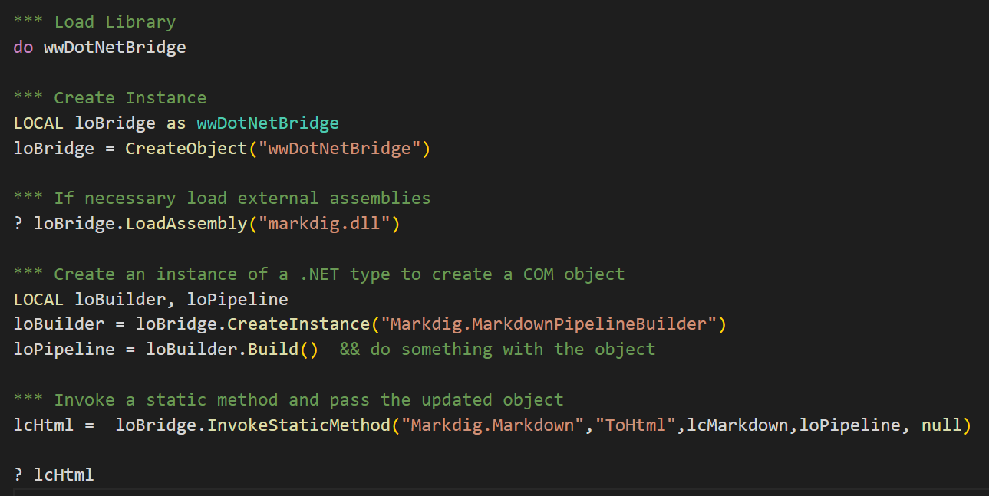
wwDotNetBridge Example

Slide 10
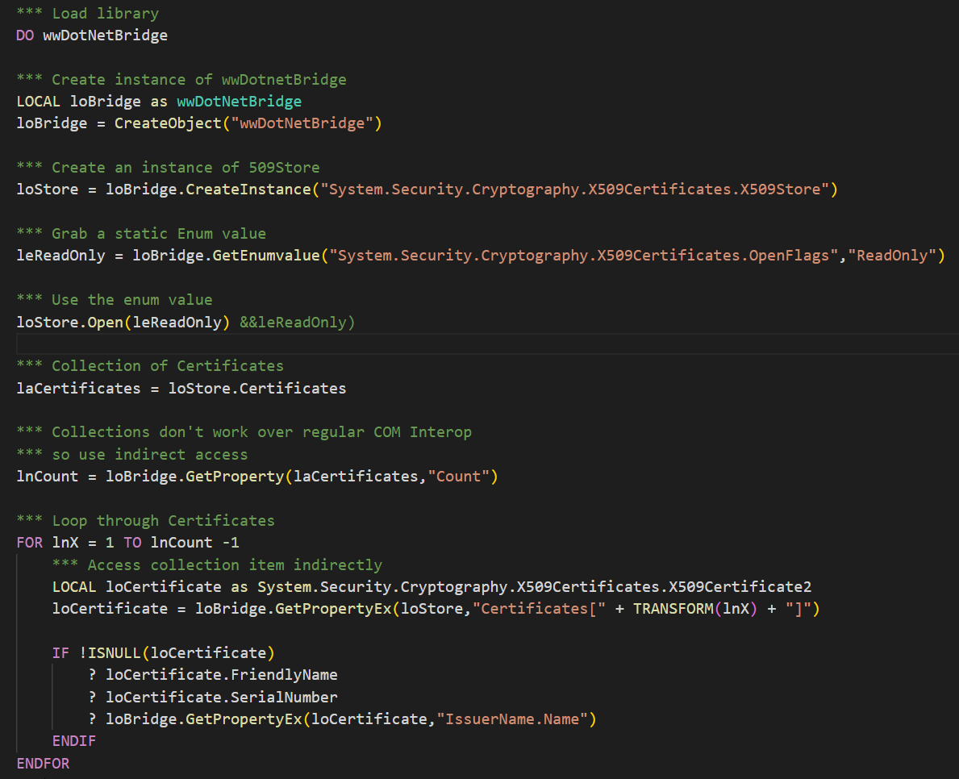

Slide 11
Creating .NET Projects
.NET Tooling has changed a lot in recent years!

Slide 12
.NET Component Development
Command Line Build Tools
You can now integrate .NET projects from any environment
Using the dotnet SDK tool
You can use any Editor and CLI Tools
Command Line tools can be integrated from anywhere
Generic OmniSharp tool is integrated into many Editors
You can use simple editors like VS Code + Command Line
SDK Tool provide Project Services
Create new Projects
Add NuGet Packages (dependencies) to Projects
Compile and Error output, run Tests
Build output assemblies
Visual Studio is still most productive
Huge development environment, but more focused
Smooth UI integration of tools
Best choice for Debugging components from FoxPro

Slide 13
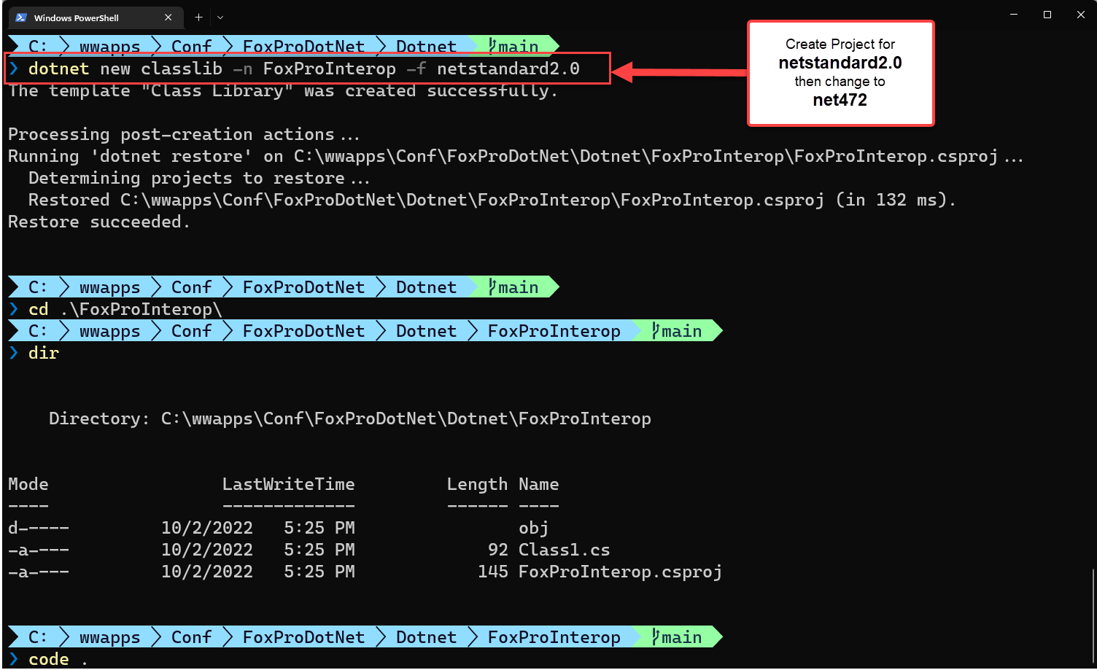

Slide 14
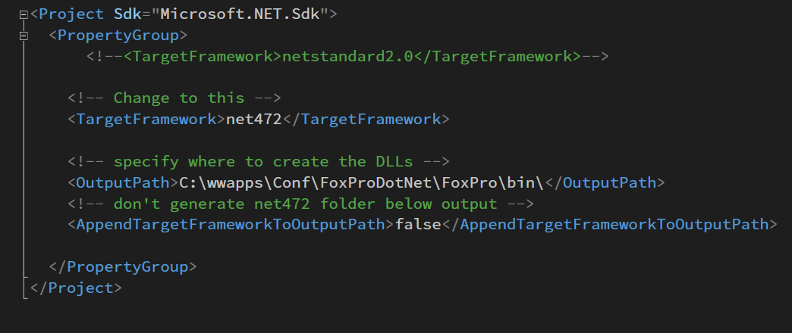
Fixing up the Project File

Slide 15
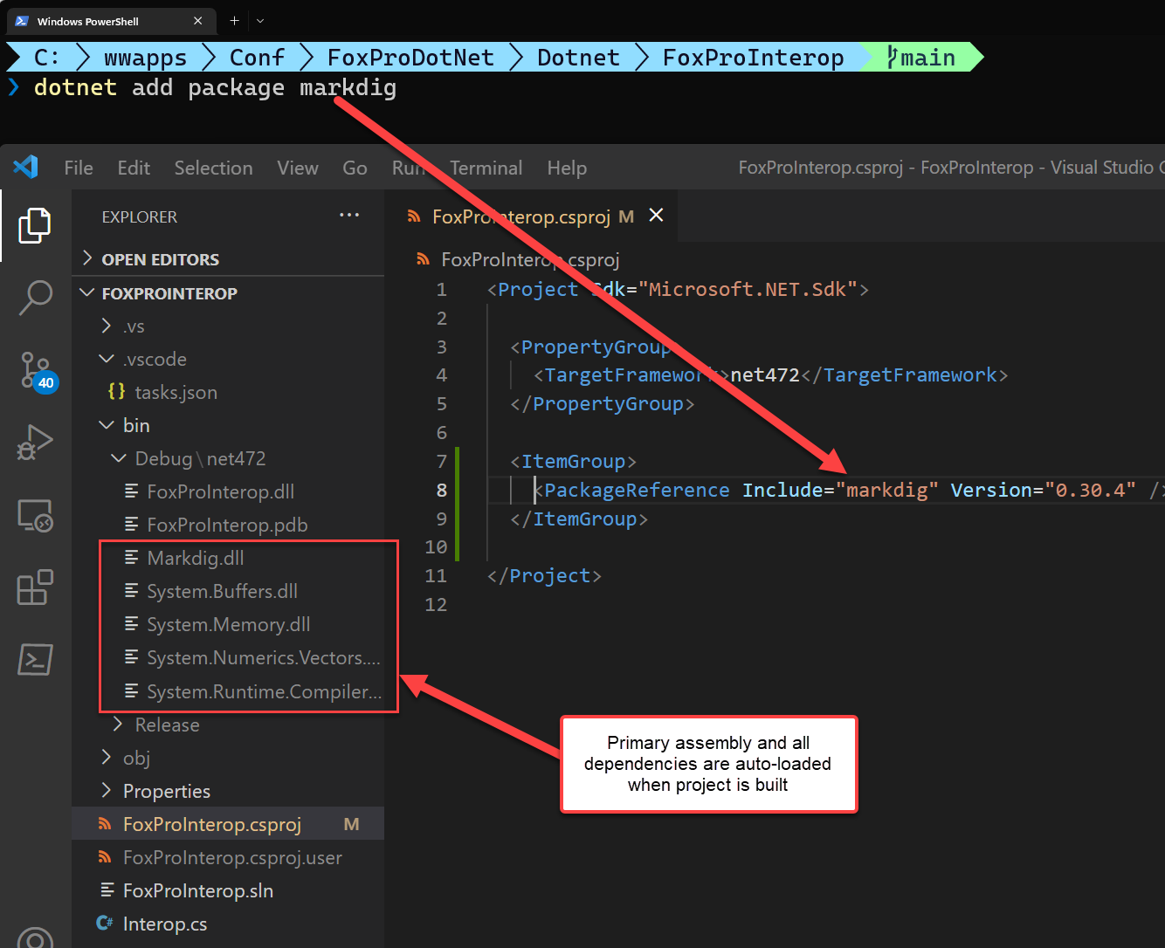
Adding NuGet Dependencies
NuGet Package Manager
Public Repository
1000’s of packages available
Install from Internet
NuGet Packages
Self-contained Package
Contains primary DLL(s)
Auto installed and referenced
Dependency Trees
Packages can reference others
Transients are auto-installed
Versioned and updatable
Easy to add to project
dotnet add package
IDEs have UI Package Managers

Slide 16
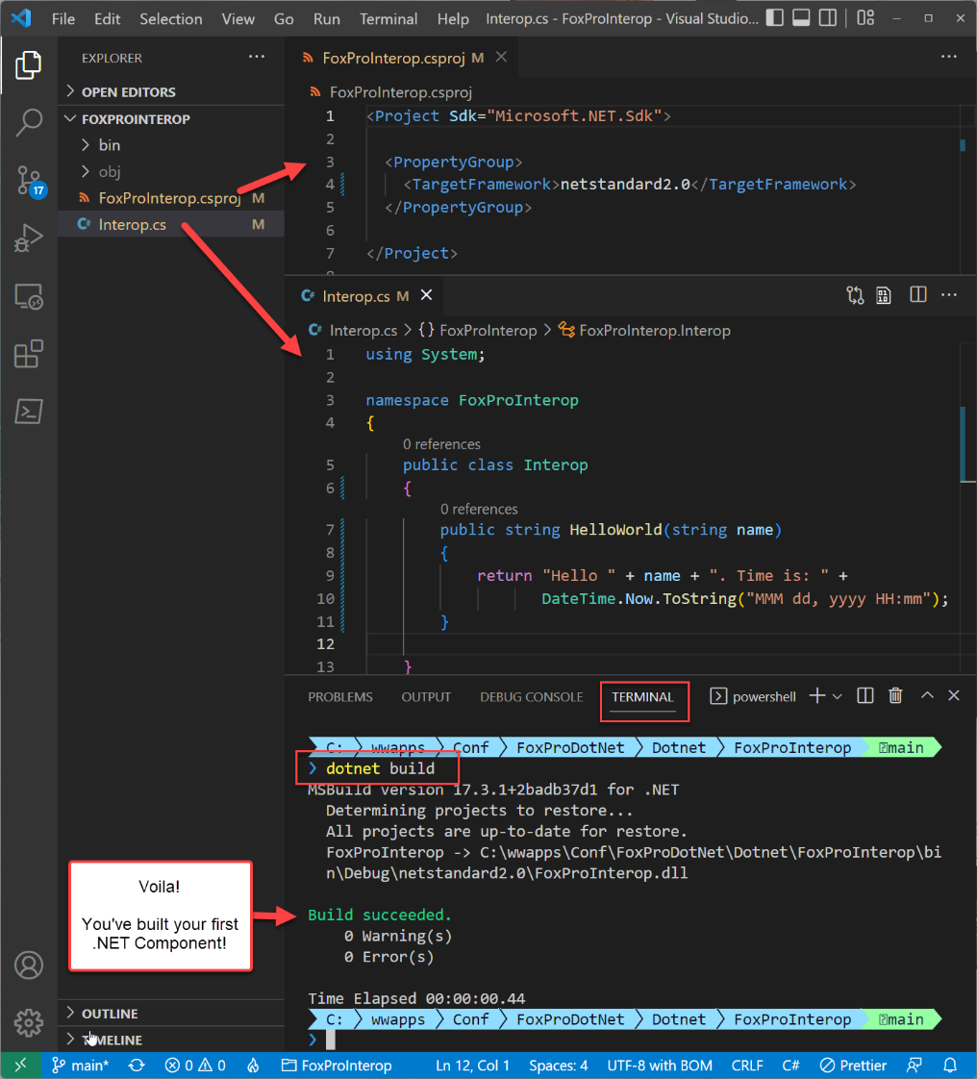
Project in VS Code
VS Code
Light weight editor
Lots of built in syntaxes
C# and .NET Support
For Interop
Modify project target to net472
Remove implicit namespaces
Remove nullability support
Change class to class syntax
Command Line to Build
Use CL to create and build project
Add NuGet packages
Build and Output .NET DLL

Slide 17
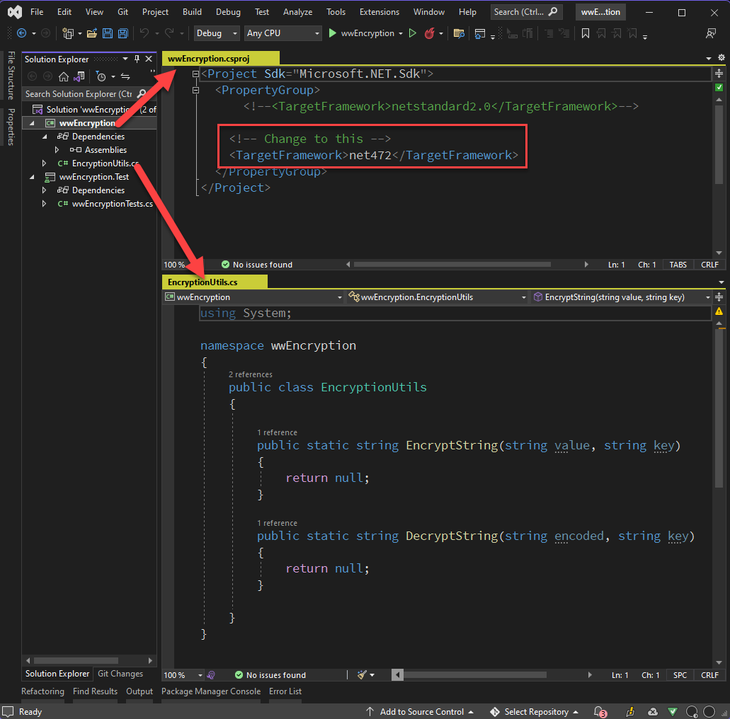
Create a Project in Visual Studio
Visual Studio: Still Huge
Large, but more focused
Free Community Edition (fully functional Pro)
Create New .NET Project
C# Class Library for .NET Core/Standard
Target .NET Standard 2.0
Modify Project
Change TargetFramework
Change to: net472
Create your .NET Class
Rename or remove Class1.cs
Use descriptive class name
Referenced from Fox: namespace.class
Don’t use same namespace as class!

Slide 18
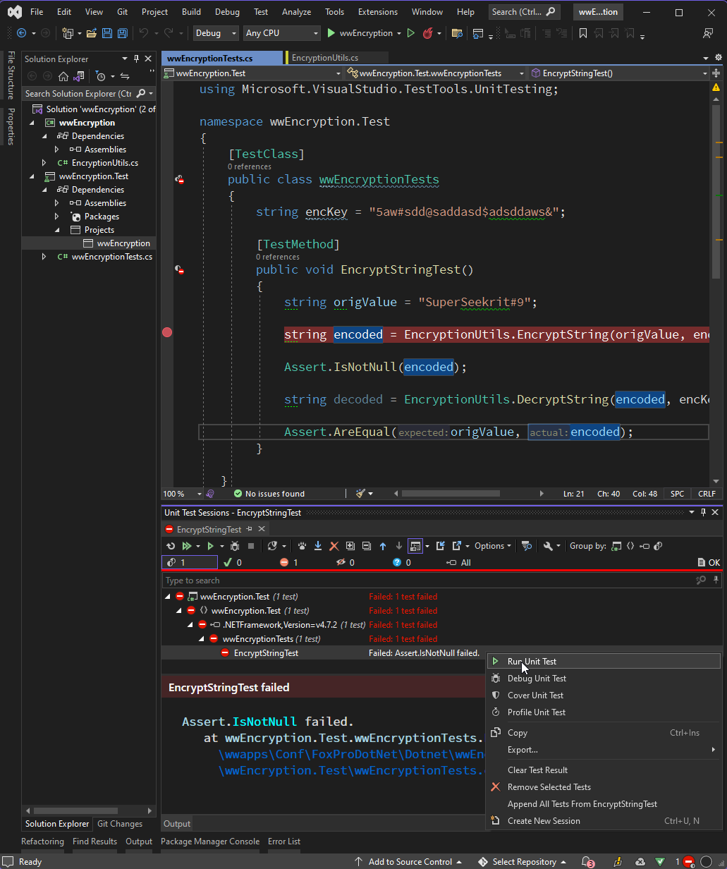
Create a Test Project
Why a Test Project?
Classlibrary can’t be run directly
Easy to test many methods
Great for debugging
Good usage documentation
Create Test Project
Add a new C# MsTest Project
Target lowest version available (net50)
Add a project reference to Classlibrary
Rename or delete Class1.cs
Create your Test class
Use [TestClass] and [TestMethod]
Asserts to verify logic
Exceptions fail tests
Run Tests
In the IDE
From Command Line (dotnet test)

Slide 19
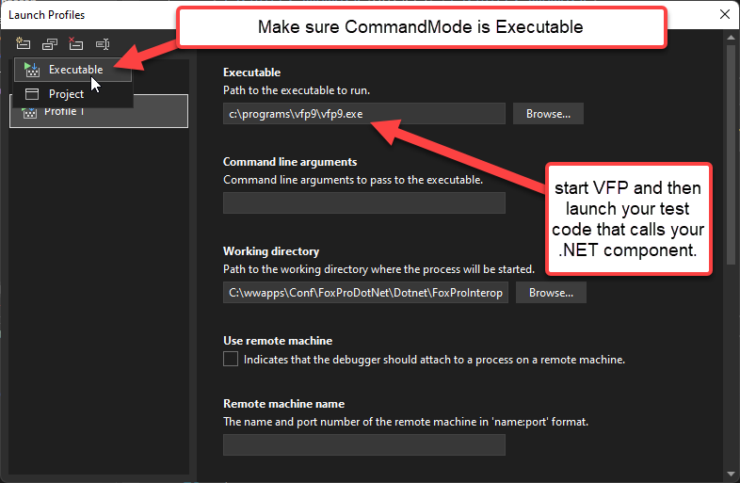
Debugging (1)
Recommend Visual Studio
Use Debug Launch Profiles
Set Mode to Executable
Specify VFP9.exe as start
Start Debug in Visual Studio
Run your test code that calls the .NET component
Code stops on breakpoint
You can then step through

Slide 20
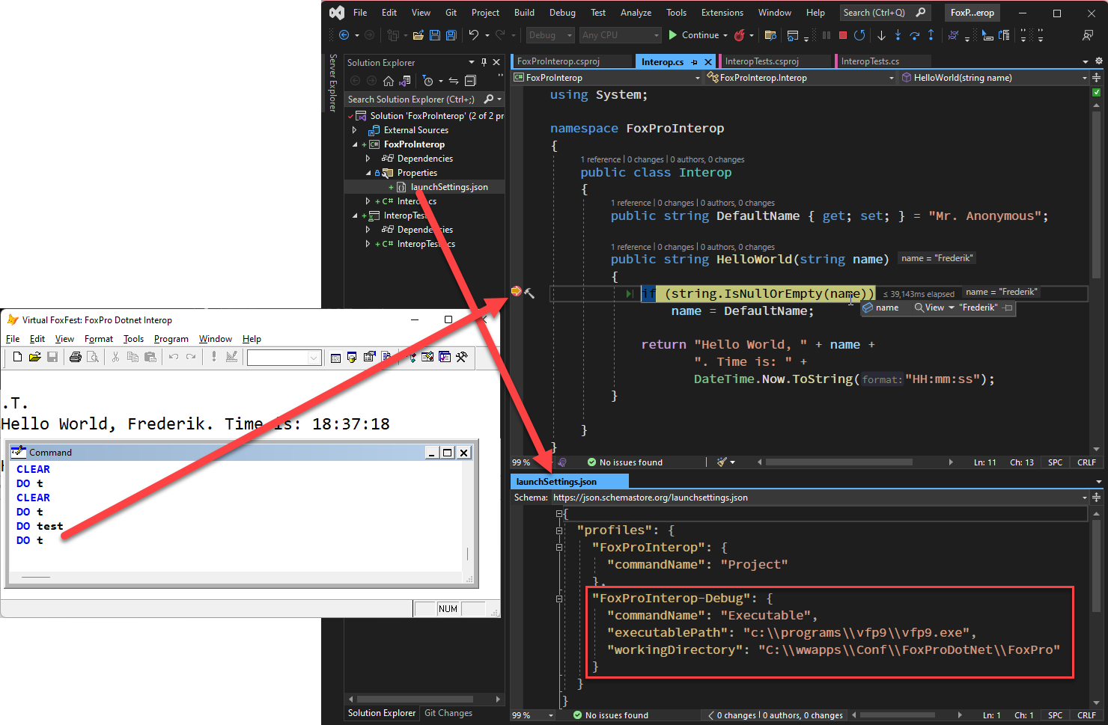
Debugging (2)
Use a Launch Profile
Executable
Point at VFP9.exe
Start in your Fox project folder
Launch Debug in Visual Studio
Launches FoxPro
Launch your FoxPro test code
Make sure right DLL gets loaded!

Slide 21
.NET Project Tips
Create Wrapper Types
Simplify library interfaces
Expose only what you need to call/interface with
Use FoxPro/COM friendly types
Create a .NET Project for your FoxPro Project
You can create many classes in a single project
Use utility classes for simple things
Prefer using static methods for one-off functionality
loBridge.InvokeStaticMethod("namespace.type", method, parm1)
Use wrapper classes for more complex scenarios
Simplify .NET interfaces for your use cases
Flatten complex hierarchies
Use FoxPro friendly types

Slide 22
Real World Use Cases
Putting .NET into FoxPro Applications

Slide 23
West Wind Web Connection
Integration Libraries
Use .NET Components to extend core Web and Development tools
Integration with built-in .NET features
Integration with third party libraries
Most use wrapper classes to hide .NET from FoxPro
Specific Examples of Built-in integrations
wwSMTP email client via built-in SmtpClient
String, UTF-8 and Unicode helpers
Specific Examples of Third Party Integrations
JSON parsing using JSON.NET
Markdown rendering via MarkDig
SFTP Support via SSH.Net
Web Server Interfaces
Web Connection ASP.NET Module IIS Connector
Web Connection .NET Core self-contained Web Server

Slide 24
Html Help Builder
Integration Libraries
Use .NET Components to extend core Web and Development tools
Integration with built-in .NET features
Integration with third party libraries
Most use wrapper classes to hide .NET from FoxPro
Library Integrations
Markdown rendering using MarkDig
JSON Parsing for configuration files using JSON.NET
HTML Parsing for HTML->Markdown conversions
SFTP Uploads using SSH.Net
Custom Integrations
Create custom .NET class using Reflection to parse .NET Libraries and extract Documentation
Custom .NET Executables (exes)
External Screen Capture Executable that allows capturing windows
Standalone Help Builder CLI Console

Slide 25
Exposing .NET Libraries
Expose .NET Functionality with a FoxPro Wrapper
Many .NET Libraries are overly complex and hierarchical
You could use wwDotNetBridge, but painful to code
Wrappers make it easier to access from FoxPro
Examples:
wwSmtp – wraps System.Net.SmtpClient
wwEncryption – Hashing and two-way encryption
wwMongoDb – Access MongoDb from FoxPro

Slide 26
.NET Interop Must Have Tools
.NET Disassembler
Examine .NET types, members etc.
Reflector (v6 free, newer commercial)
DotPeek (free)
JustDecompile (free)
LinqPad – The Command Line for .NET
Test .NET Code Snippets
Great for experimenting with .NET
Has IntelliSense to discover interfaces
Use to run .NET code before accessing with wwDotNetBridge
LinqPad 5 for .NET Framework, Latest for .NET Core (v7)

Slide 27
Thank you!
Resources
Github: Source Code, White Paper and Slides https://github.com/RickStrahl/VirtualFoxFest2022-FoxProDotnet
Contact Rick
@RickStrahl on Twitter
https://weblog.west-wind.com – general blog
https://west-wind.com/wconnect/weblog/ - Fox blog
https://support.west-wind.com - support message board
https://github.com/RickStrahl - GitHub Projects
rstrahl@west-wind.com

